Slide 1
Flutter and AI, Machine Learning & Deep Learning
Turtorial

Slide 2

Spear Yao
Former Vice President at Citibank Global Technology Center
Former Financial IT Specialist at Bank of America Merrill Lynch (China)
Member of Citi’s Technology Expert Committee
Member of Citi’s Innovation Committee
Global inventor of the Human Capital Finance
Inventor of the Personal Value Index
Long-term resident and professional based in Singapore

Slide 3


Practice within AI tools and data
Personal Site:http://spearyao.liveblog365.com/
Github: https://github.com/spearsharp/AI_training.git
GIT
Personal Site

Slide 4
Training Overview
Duration: 3 Days (24 hours total)
Format: 90% Theory, 10% Practical
Audience: Government & Enterprise IT Professionals
Goal: Understand AI, ML, DL & LLMs (Deepseek,LLaMA, Hugging Face, TensorFlow).

Slide 5
Day 1

Slide 6
What is AI & Its History
Definition and significance of AI
Categories: ML, DL, NLP, RL
Importance of AI in solving complex problems across industries
History: Turing Test, symbolic AI → ML → Deep Learning
Future: AGI (Artificial General Intelligence)

Slide 7
Definition and significance of AI
Reference Type | Title | Source / URL
Original Paper (Source) | Computing Machinery and Intelligence | JSTOR link to the original article in Mind
Academic Citation | Turing, A. M. (1950). Computing Machinery and Intelligence. Mind, 59(236), 433–460. | N/A
Encyclopedia Entry | The Turing Test | Stanford Encyclopedia of Philosophy—provides in-depth context and analysis

Slide 8
Division of AI
👁️ 1. Vision (Computer Vision)
AI for visual perception, object recognition, and image and video understanding.
OpenCV — classic computer vision library for image processing.
👂 2. Audition (Audio & Speech AI)
AI that understands, generates, and processes sound, speech, and music.
Whisper (OpenAI) — automatic speech recognition (ASR).
👃 3. Olfaction (AI for Smell)
AI that models chemical sensing, odor recognition, and olfactory perception — an emerging but rapidly growing field.
Google Brain’s “AI Olfaction Model” — trained on molecular structures to predict odor profiles.
🖐️ 4. Tactile AI (Touch & Physical Interaction)
AI that senses pressure, texture, temperature, and shape through touch — essential for robotics, prosthetics, and industrial automation.
GelSight (MIT): optical tactile sensors that map surface texture at micron resolution.
👅 5. Gustatory AI (Taste)
AI systems designed to simulate or evaluate taste perception through chemical or sensor data.
Electronic Tongues (e-tongues) — sensor arrays that detect chemical compositions in food, water, or drugs.
🧭 6. Proprioceptive AI (Body Awareness)
AI that senses position, movement, and force — crucial for humanoid and autonomous robotics.
DeepMind’s Control Suite / Isaac Gym (NVIDIA) — physics simulators for proprioceptive training.
🧩 7. Toward Multisensory or Embodied AI
Future systems combine Vision + Audition + Touch + Smell + Taste + Motion, enabling human-like sensory integration.
DeepMind’s Gato — a multimodal, multi-task agent (early embodied intelligence).
🔮 8. The Future: “Six-Sense AI”
The frontier is embodied cognition, where AI:
Understands through interaction, not just data.
Feels and manipulates the world like humans.
Learns continuously via sensory feedback loops.
Think:
“AI that doesn’t just see or hear — but touches, tastes, smells, and moves through the world.”

Slide 9
Categories: ML, DL, NLP, RL
Tool Type | Primary Tool / SDK/Platform/Community | Key Features & Use Cases
Foundational Library | Scikit-learn (Highly Recommended) | The most popular Python library for traditional ML. Covers classification, regression, clustering, and dimensionality reduction. Simple, consistent API.
Data/Numeric | Pandas | Essential for data manipulation and analysis. Provides DataFrames for structured data handling.
Python ML Liberary | NumPy | Fundamental library for scientific computing, especially for arrays and linear algebra operations.
Model Deployment | ONNX (Open Neural Network Exchange) | An open standard format to represent ML models. Allows models trained in one framework (e.g., PyTorch) to be deployed using another (e.g., TensorFlow Serving).
Kaggle API/CLI Tool(Pre-trained Models) Community | kaggle | Kaggle is an online community and platform for data scientists and machine learning engineers.
Cloud Platforms | Amazon SageMaker | Fully managed service for building, training, and deploying ML models at scale.
 | Google Vertex AI | Unified platform for the entire ML workflow, from data to deployment (includes AutoML).

Slide 10
Importance of AI in solving complex problems across industries
The Core Value of AI
In all these cases, AI is important because it provides four key capabilities to solve complex problems:
Scale: It handles data volumes ($ \text{petabytes}$) that would overwhelm a human team.
Speed: It processes information and makes decisions in real-time, which is essential for dynamic systems like financial markets or autonomous vehicles.
Pattern Recognition: It finds non-obvious, non-linear relationships and hidden patterns in data that a human or traditional statistical model would miss.
Autonomy: It can execute complex optimization tasks (route planning, resource allocation)without constant human oversight.

Slide 11
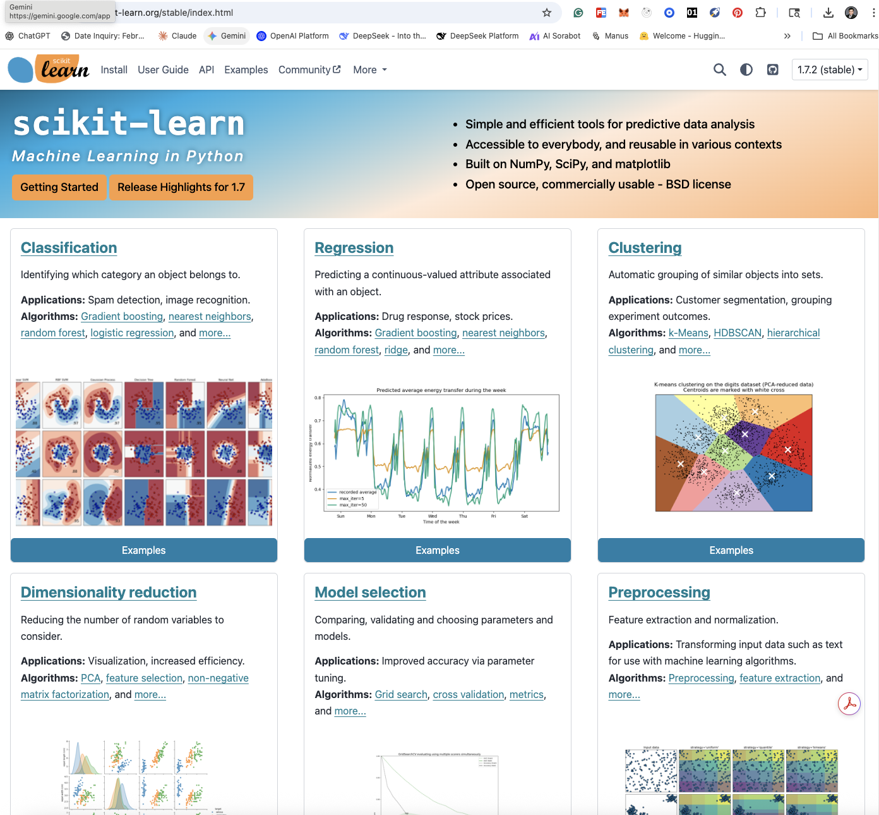
Scikit-learn
Github
Official Site

Slide 12
History: Turing Test, symbolic AI → ML → Deep Learning
Summary of the Evolution:
Turing Test (1950): The starting point. Turing proposed the "Imitation Game" to answer the question, "Can machines think?" This defined the goal of AI.
Symbolic AI (GOFAI): Directly following the Dartmouth Conference, researchers believed intelligence could be achieved by manipulating explicit symbols and logical rules (e.g., expert systems and logical deduction).
Machine Learning (ML): As Symbolic AI failed to scale to real-world complexity, the focus shifted to statistical methods where machines learned rules and patterns from data rather than being explicitly programmed with them (e.g., decision trees, support vector machines).
Deep Learning (DL): A subset of ML that uses multi-layered neural networks (connectionism). Its success is due to vast amounts of data and computational power, allowing models to automatically learn hierarchical, abstract features, leading to massive breakthroughs in perception and language.

Slide 13
Future: AGI (Artificial General Intelligence)
Definition | Source | URL (Example Reference)
Artificial General Intelligence (AGI) refers to a theoretical AI system with capabilities that match or exceed human cognitive abilities across a wide range of tasks, including reasoning, problem-solving, learning, and adaptation in new and unseen situations. | Google Cloud, IBM, AWS, and Academic Papers | https://cloud.google.com/discover/what-is-artificial-general-intelligence
Key Research Paper/Framework | "Levels of AGI for Operationalizing Progress on the Path to AGI" - A framework used by researchers to define and measure progress toward AGI. | https://arxiv.org/pdf/2311.02462

Slide 14
Current Tech Trends, Projects, and Code Examples for AGI
Tech Trend Driving AGI | Description & Contribution to AGI | Project/Company Name | Associated Code/Mechanism
Agentic AI & Orchestration | Enables current models to become autonomous agents that can plan, reason, use tools, and execute multi-step goals without human intervention. This is a critical step towards AGI's general problem-solving ability. | LangChain / AutoGen / CrewAI (Open-source frameworks) | Function Calling / Tool Use (LLM code)
Multimodality & World Models | Developing models that can seamlessly process, generate, and reason across multiple data types (text, code, image, video). This creates a richer "understanding of the world" akin to human perception. | Google Gemini / OpenAI GPT-4o / DeepMind's Gato | Transformer Architectures with specialized multimodal encoders.
Neural-Symbolic AI (Hybrid Systems) | The attempt to combine the learning power of Deep Learning (connectionism) with the logical reasoning and transparency of Symbolic AI (GOFAI). This aims to solve the "common sense" problem. | DeepMind's AlphaGo (which used a neural network guided by a symbolic search algorithm, Monte Carlo Tree Search) | Reinforcement Learning guided by a Search/Planning Algorithm (e.g., Monte Carlo Tree Search - MCTS)
Enhanced Reasoning (CoT) | Techniques that force a Large Language Model (LLM) to show its "work" by outputting a logical sequence of steps before the final answer, significantly improving complex reasoning tasks. | LLMs (e.g., GPT-4) | Chain-of-Thought (CoT) Prompting (A specific prompt engineering technique)

Slide 15
Frontier of AI – SAI(Super AI)/ASI(Artificial Super Intelligence)
🚀 The Pursuit of Superhuman Capability
The path to ASI starts with AGI. Frontier labs like OpenAI and Google DeepMind are developing massive multimodal models (GPT-4o, Gemini) that integrate text, code, images, audio, and video—essential for general intelligence.
1. Advanced Architectures
Multisensory AI: Systems processing multiple data types simultaneously
AI-Generated Programming: Autonomous code writing and optimization, enabling recursive self-improvement toward an "intelligence explosion"
2. Computing Paradigms New computational methods push beyond current hardware limits:
Neuromorphic Computing: Brain-mimicking hardware for efficiency and parallelism
Quantum Computing: Leveraging quantum mechanics for unprecedented speed and complex problem-solving

Slide 16
AGI,ASI
Feature | Artificial General Intelligence (AGI) | Artificial Superintelligence (ASI)
Level of Intelligence | Human-Equivalent | Vastly Superior to the best human minds.
Scope of Ability | Can perform any intellectual task a human can. | Can perform all intellectual tasks, far better than any human can, and solve problems humans cannot conceive of.
Current Status | Theoretical (Not yet achieved) | Purely Theoretical (The stage after AGI)
Primary Challenge | How to build it (Replicate human cognition). | How to control it and align it with human values (The Alignment Problem).

Slide 17
Practical (15 min):
Brainstorm:
Open discussion on AI history and how AI impacts current industries and sectors.

Slide 18
AI Applications in Government
Citizen Services – AI chatbots
Smart Cities – Traffic, environment, infrastructure
Public Security – Surveillance & anomaly detection
Healthcare – Predictive analytics
Finance – Fraud detection
Education – Personalized learning(Demo: Student Behavior Detection)

Slide 19
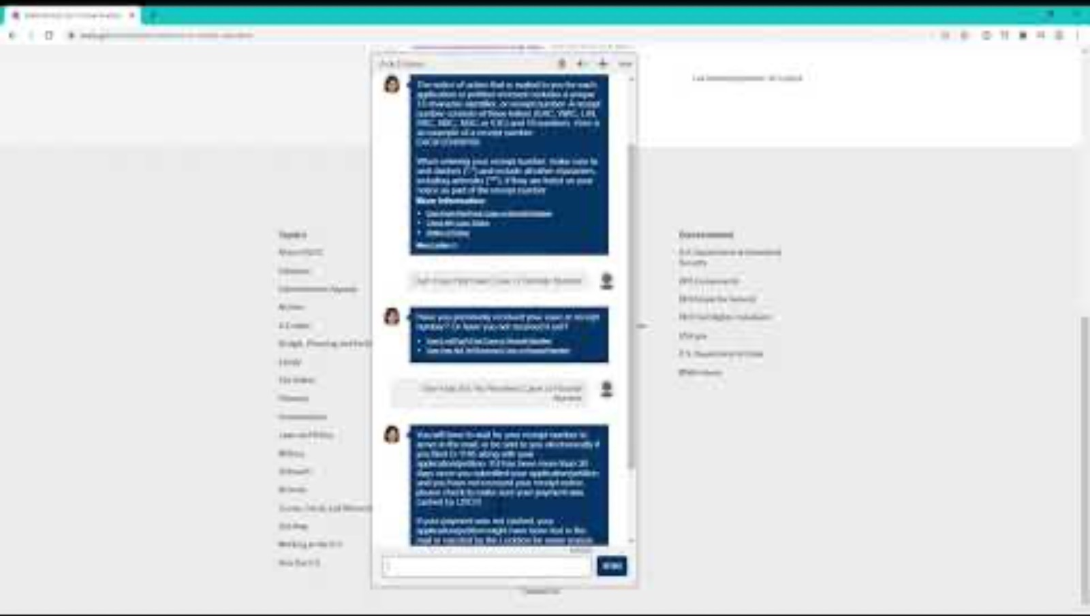
Citizen Services – AI chatbots
Feature | Detail
Use Case | Immigration and Citizenship Guidance.
Organization | U.S. Citizenship and Immigration Services (USCIS)
Solution Name | "EMMA" (named after Emma Lazarus)
Goal | To help applicants and citizens with high-volume requests regarding immigration processes, green cards, passports, and general service information.
Key Impact | * Handles over 1 million interactions per month, significantly reducing the burden on call centers and human agents.
 | * Supports both English and Spanish languages.
Source | U.S. Department of Homeland Security / Industry Reports (e.g., VSoft Consulting, OECD).
Meet Emma

Slide 20
Smart Cities – Traffic, environment, infrastructure (Smart Traffic Light)
Category | Instance | Use Case | Key Impact/Source
Traffic | Pittsburgh, Pennsylvania, USA (using Surtrac system) | Adaptive Traffic Signal Control: An AI-driven system that uses real-time data from sensors and cameras to dynamically adjust signal timings at intersections. | Key Impact: Reduced vehicle wait times at intersections by approximately 40% and cut citywide traffic emissions by 21% due to less vehicle idling.
 |  |  | Source: Reports on Pittsburgh's Surtrac system (e.g., AITUDE, Digi International, Omnisight).

Slide 21
Public Security – Surveillance & anomaly detection
Company/Platform | Best For | Key AI Features
NVIDIA Metropolis | Smart Cities & Critical Infrastructure | A comprehensive application framework that combines GPU-optimized software, pre-trained models, and an SDK to build and deploy intelligent video analytics (IVA) for object detection, traffic monitoring, and anomaly detection.
Google Cloud Video Intelligence | Media & Security Analytics | Provides pre-trained machine learning models that automatically enable video-level, shot-level, and per-frame insights, including object tracking and content moderation.
Microsoft Azure Video Analyzer | Microsoft Ecosystem Integration | A service that enables building live video analytics applications with plug-and-play AI models and extending on-premises or edge-based video systems to the cloud.
Genetec Security Center | Critical Infrastructure & Unified Security | A holistic security platform that integrates video surveillance (VMS), access control, and license plate recognition (LPR), with advanced AI analytics for threat detection.
icetana AI | Specialized Video Anomaly Detection | Provides software that learns what is "normal" in an environment and automatically alerts staff only to unusual and atypical behavior, reducing monitoring fatigue and false alarms.
Motorola Solutions (Avigilon) | Real-Time Public Safety | Solutions like Avigilon Appearance Search™ technology allow operators to quickly search and track a specific person or vehicle across large networks of cameras.

Slide 22
Healthcare – Predictive analytics(Diagnose system)
Project Name (GitHub Link) | Focus & Key Features | Predictive Use Cases
PyHealth (sunlabuiuc/PyHealth) | A comprehensive deep learning Python toolkit for clinical predictive modeling. It provides standardized datasets (like MIMIC-III, eICU), pre-built models, and a modular 5-stage pipeline for healthcare ML. | Patient hospitalization prediction, Mortality prediction, Length of Stay forecasting, Diagnosis-based drug recommendation.
MONAI (Project-MONAI/MONAI) | A PyTorch-based framework for medical imaging AI. While not strictly predictive analytics on EHR data, it's essential for predicting outcomes from images. | Image-based Risk: Predicting tumor malignancy/progression, classifying disease presence (e.g., pneumonia detection from X-rays).
DCMTK (DCMTK) | DICOM Toolkit. Essential for handling medical images, which are often used as input for predictive models in radiology and pathology. | Preprocessing and analysis of medical image data for disease detection.
Healthcare.ai (HealthCatalyst/healthcare.ai) | A Python and R library specifically for healthcare machine learning that focuses on making deployment simple and includes functions for common healthcare tasks. | General clinical risk prediction, churn/no-show prediction, cost modeling.

Slide 23
Finance – Fraud detection(Antifraud)
How AI Anti-Fraud Loan Systems Work These systems analyze vast amounts of data—far beyond what human analysts can process—to detect suspicious patterns and anomalies.
Key Mechanisms:
Data Analysis and Feature Engineering: The system aggregates and processes diverse data points, including application information (income, employment, address), credit history, device information, behavioral patterns during the application, and transaction history.
Model Training (Supervised and Unsupervised Learning): Supervised Learzning: Models are trained on historical data labeled as either legitimate or fraudulent to recognize known patterns, such as forged documents or common identity theft tactics. Unsupervised Learning (Anomaly Detection): Models analyze new, unlabeled data to spot deviations from a "normal" established behavior baseline. This is crucial for catching new, emerging, or previously unseen fraud schemes that do not fit known patterns.
Risk Scoring and Real-Time Monitoring: Risk Scoring: Algorithms assign a risk score to each loan application or transaction based on the probability of it being fraudulent. Real-Time Detection: The system analyzes data and behavior in milliseconds as the application or transaction occurs, allowing for immediate flagging or blocking of suspicious activity.
Adaptive Learning: Unlike traditional rule-based systems with static rules, AI models continuously learn and adapt from every new application, fraud attempt (successful or unsuccessful), and investigation outcome, making them increasingly accurate over time.

Slide 24
Education – Personalized learning(Demo:Student Behavior Detection)
💡 Key Personalized Learning Concepts to Implement
When building a personalized learning project, your SDK/tool selection should facilitate these core functions:
Adaptive Content: Showing different materials (videos, readings, exercises) based on the student's pre-assessment results or real-time performance.
Dynamic Pacing: Allowing a student to skip content they've already mastered or providing extra support on topics where they struggle.
Learner Modeling: Tracking a student's knowledge state, preferences, and goals (often stored in a database like MongoDB or PostgreSQL) to inform the personalization engine.
Recommendation Engine: Using algorithms (often simple filtering or more complex ML) to suggest the "next best activity" for the student.

Slide 25
Practical (30 min):
Application Demo:
Illustrate an application of leveraging LLM DeepSeek APIs to realize an embedded AI assistant in office software (Word, Excel, etc.) in our routine work.
LLM: DeepSeek
API：Token : Excel (OpenAPI : golang deployed : Please ACC. PWD to access)
Office Ai assitant practice: VBS/JS to embeded DS into Office Tool

Slide 26
AI Landscape & Foresight
From narrow AI → general-purpose AI
Multimodal AI (text, image, speech)
Edge AI & AI for IoT
Trends: RL, Unsupervised, Few-shot Learning

Slide 27
From narrow AI → general-purpose AI
Feature | Artificial Narrow Intelligence (ANI) / Weak AI | General-Purpose AI Agents (GPAIs) / Agentic AI
Core Function | Task-Specific: Excels at a single, narrowly defined task. | Goal-Oriented & Autonomous: Can decompose complex goals into multi-step tasks and execute them.
Learning/Adaptation | Relies on Supervised Learning on labeled, specific data. Cannot perform tasks outside its training domain. | Uses Transfer Learning and In-Context Learning (from LLMs) to apply knowledge to novel, unseen problems.
Content/Data Scope | Narrow, specialized datasets (e.g., millions of cat pictures, specific transaction logs). | Multimodal Foundation Models trained on massive, diverse data (text, code, images, video) from the internet.
Interaction | Reactive/Passive: Responds to a specific prompt (e.g., "Set a timer," "Is this a dog?") | Proactive/Agentic: Can sense the environment, maintain memory, decide on optimal actions, and execute tool calls.
Examples | Siri/Alexa voice commands, Spam filters, Netflix recommendations, Image classification models. | Autonomous workflow bots (AutoGPT, LangGraph), AI personal assistants managing email and scheduling across multiple apps, complex data analysis agents.

Slide 28
Multimodal AI (text, image, speech)
Gemini , GPT-4o
Input Modality | Output Modality | Example Task
Text | Image | Generating an image from a detailed written prompt (Text-to-Image).
Image | Text | Generating a descriptive caption or summarizing the contents of a photo (Image Captioning).
Speech | Text | Transcribing spoken language with high accuracy by analyzing background sounds and context.
Text + Image | Text | Answering a complex question about an uploaded photo (Visual Question Answering).
Speech + Image | Text + Speech | A virtual assistant processing a voice command about an object it's seeing via a camera and responding in a conversational voice.

Slide 29
The rise of Edge AI and AI for IoT (Internet of Things) devices(Senarios)
Industry | Use Case (Instance) | Edge AI Action on the Device | Benefit
Industrial IoT (IIoT) | Predictive Maintenance | Analyzes vibration/temperature sensor data in real-time to detect an anomaly (e.g., a bearing failure signature) and sends an immediate alert. | Prevents catastrophic equipment downtime; saves millions in unplanned repairs.
Smart Cities | Intelligent Traffic Management | Processes video locally from traffic cameras to count vehicles, measure queue length, and adjust traffic lights instantly. | Reduces traffic congestion and latency-critical cloud transmission costs.
Retail | Loss Prevention/Inventory | Uses on-shelf cameras to run object detection, identifying an item removed without being paid for, or detecting low stock levels. | Reduces 'shrinkage' (theft) and enables real-time restocking alerts.
Healthcare | Remote Patient Monitoring | A wearable device analyzes physiological data (EKG, blood oxygen) to detect an irregularity and immediately alert the patient/caregiver. | Provides life-critical, zero-latency response while ensuring patient data privacy (HIPAA/GDPR compliance).
Consumer/Smart Home | Voice Command Processing | A smart speaker or doorbell processes the wake-word and initial command locally. | Improves response speed and ensures private conversations don't leave the device until the wake-word is detected.

Slide 30
The rise of Edge AI and AI for IoT (Internet of Things) devices - sdk
SDK/Runtime | Purpose | Target Devices
TinyML SDKs (e.g., for Arduino) | Deploys extremely small, efficient ML models (often for keyword spotting or sensor anomaly detection) onto microcontrollers. | Microcontrollers (MCUs) with limited memory (kilobytes) and low power (milliwatts).
ONNX Runtime | A universal runtime for running models created in various frameworks (PyTorch, TensorFlow, etc.) after they have been converted to the Open Neural Network Exchange (ONNX) format. | General-purpose CPUs, embedded systems, and mobile devices.
Azure IoT Edge Runtime | Allows developers to deploy cloud services, including pre-trained Azure ML models, as containerized modules onto gateway or server-level edge devices. | Edge Servers, Gateways, and high-end industrial PCs running Linux or Windows.
Arm CMSIS-NN | A collection of optimized neural network functions specifically designed for Arm Cortex-M microcontrollers. | Microcontrollers commonly used in battery-powered IoT devices.

Slide 31
The Future of AI: Trends in reinforcement learning, unsupervised learning, and few-shot learning
Trend | Description | Impact
Offline/Batch RL | Agents learn optimal policies from pre-collected, static datasets (batch data) rather than requiring costly and risky live interaction with the environment. | Enables RL to be safely deployed in sensitive domains like healthcare (treatment planning) and finance (algorithmic trading) where trial-and-error is impossible.
RL with Human Feedback (RLHF) | Integrating human evaluation and preference rankings into the RL process to align model behavior with human values, ethics, and intent. | Crucial for fine-tuning large generative models (like LLMs) to make them safer, more helpful, and less prone to harmful outputs.
Improved Sample Efficiency | Developing Model-Based RL (MBRL) approaches, where the agent first learns a model of the environment, drastically reducing the number of real-world interactions needed to find an optimal policy. | Makes RL practical for robotics and autonomous systems where every real-world interaction is expensive or time-consuming.
Safety and Robustness | Focus on Constrained RL to ensure agents learn policies that satisfy critical safety constraints (e.g., a self-driving car must never cross the median). | Essential for the deployment of autonomous systems in high-stakes environments like logistics, energy grids, and manufacturing.

Slide 32
Practical (15 min):
Group Discussion: How do you use AI in your daily life and work? Discuss ways AI could improve government services.
Train your private LLM model and practice to use ML and DL tensorflow, matplotlib.pyplot or PyTorch(Highly recommended)

Slide 33
AI Infrastructure & Strategic Planning
Components: Data pipelines, model training, APIs
Deployment: Cloud vs On-premise
Tools: TensorFlow, PyTorch, Hugging Face
Governance: Ethics, transparency, data protection

Slide 34
AI system components: Data pipelines, model development, and API integration
Vendor | Instance/Product Line | Typical Use Case
NVIDIA (The dominant player) | NVIDIA H200/H100 Tensor Core GPU (Hopper Architecture) | State-of-the-art for large-scale AI Model Training (e.g., Large Language Models like GPT, complex computer vision models).
 | NVIDIA A100 Tensor Core GPU (Ampere Architecture) | High-performance training and inference in data centers; a proven, highly-scalable standard.
 | NVIDIA L40S/RTX Series (e.g., RTX 4090) | High-end AI inference, rendering, and smaller-scale model training on workstations or more accessible servers.
AMD | AMD Instinct MI300 Series | Competing high-performance accelerator for cloud and HPC workloads, including AI training and inference.

Slide 35
AI system components: Data pipelines, model development, and API integration
AI system components: Data pipelines, model development, and API integration (Fast API,Docker)
Comparing AI deployment models: Cloud-based vs on-premise solutions (AWS, Azure, GCP, private data centers)
Tools and frameworks: TensorFlow, PyTorch, Hugging Face, etc.
Hardware: GPUs, TPUs, and accelerators for AI workloads

Slide 36
AI system components: Data pipelines, model development, and API integration
Vendor | Instance/Product Line | Typical Use Case
Google | Cloud TPU v5p | Ultra-high performance for large-scale AI training and massive deep learning models (e.g., large-scale language model training).
 | Cloud TPU v5e | A versatile, cost-efficient option for both training and inference tasks, offering great throughput per dollar.
 | Edge TPU (Google Coral) | On-device inference for low-power edge devices like smart cameras and IoT gateways.

Slide 37
AI system components: Data pipelines, model development, and API integration
Vendor | Instance/Product Line | Type/Architecture | Typical Use Case
Intel | Intel Gaudi (e.g., Gaudi 3) | AI ASIC | Data center-scale AI training and inference, offering a competitive alternative to GPUs.
 | Intel Movidius VPU (e.g., in Neural Compute Stick 2) | Vision Processing Unit (VPU) | Edge inference and computer vision in low-power, compact devices.
NVIDIA | NVIDIA Jetson Modules (e.g., Jetson AGX Orin) | System-on-Module with a GPU core | Embedded and Edge AI for autonomous machines, robotics, and industrial IoT that require high-performance inference.
Qualcomm | Qualcomm AI Engine / Hexagon NPU | Neural Processing Unit (NPU) | On-device inference in smartphones, AR/VR headsets, and IoT, optimized for power efficiency.
Hailo | Hailo-8 | Dedicated Edge AI ASIC | Highly efficient edge inference in power-constrained environments like smart cameras and industrial inspection systems.

Slide 38
AI Strategy Development for Government IT
Building an AI strategy: Identifying high-impact use cases, setting KPIs, and managing resources
Navigating regulatory compliance and ensuring transparency and accountability

Slide 39
Practical (35 min):
Group Discussion: How do you use AI in your daily life and work? Discuss ways AI could improve government services.
Use DeepSeek Huggin face to Setup your private MCP , Further more create your own AI Agent.

Slide 40
Day 2

Slide 41
ML Overview
ML pipeline: Data → Training → Testing → Evaluation
Models: Linear Regression, Decision Trees, Random Forests
Metrics: Accuracy, Precision, Recall, F1-Score

Slide 42
ML pipeline: Data → Training → Testing → Evaluation
The typical Machine Learning (ML) pipeline is a systematic process for developing, deploying, and maintaining an ML model. It is a cyclical process, with each stage building upon the last to create a reliable and accurate system.

Slide 43
ML Overview
Classification Evaluation Metrics
Accuracy Accuracy is the most straightforward metric.
It measures the proportion of total predictions that were correct.
2. Precision (Purity of Positive Predictions)
Precision measures how many of the items the model predicted as positive are actually positive. It answers the question: "Of all the times the model cried wolf, how often was it a real wolf?”
3. Recall (Completeness of Positive Identification)
Recall (also known as Sensitivity or True Positive Rate) measures how many of the actual positive cases the model correctly identified. It answers the question: "Of all the real wolves, how many did the model find?”
4. F1-Score (Harmonic Mean of Precision and Recall)
The F1-Score is a way to combine Precision and Recall into a single metric. It is the harmonic mean of the two, which heavily penalizes models that have very low Precision or very low Recall.

Slide 44
ML pipeline: Data → Training → Testing → Evaluation
Stage | Step-by-Step Activities | Key Input | Key Output
1. Data (Preparation) 📊 | 1.1 Collection: Gather raw data from sources. | Raw Data (e.g., CSV, database) | Cleaned, Usable Data
 | 1.2 Cleaning: Handle missing values, correct errors, remove noise. | Raw Data | Cleaned Data
 | 1.3 Preprocessing & Feature Engineering: Scale/normalize numerical features, encode categorical features, create new features. | Cleaned Data | Training Set, Testing Set
 | 1.4 Splitting: Divide data into Train ($\approx 70-80\%$) and Test ($\approx 20-30\%$). | Cleaned Data | Training Data
2. Training (Learning) ⚙️ | 2.1 Model Selection: Choose an algorithm (e.g., Logistic Regression, CNN). | Training Data | Untrained Model
 | 2.2 Initialization: Initialize the model's parameters (weights and biases) randomly. | Training Data | Initialized Model
 | 2.3 Iterative Optimization: Perform the forward pass to calculate predictions, calculate the loss (error), use Backpropagation to compute gradients, and finally, use an optimizer (e.g., Gradient Descent) to update parameters. | Training Data, Model | Trained Model

Slide 45
ML pipeline: Data → Training → Testing → Evaluation
Stage | Step-by-Step Activities | Key Input | Key Output
3. Testing (Validation) ✅ | 3.1 Prediction: Feed the Testing Set features ($X_{\text{test}}$) into the trained model to generate predictions ($\hat{Y}_{\text{test}}$). | Trained Model, $X_{\text{test}}$ | Predictions ($\hat{Y}_{\text{test}}$)
 | 3.2 Comparison: Compare the predictions ($\hat{Y}_{\text{test}}$) against the actual true labels ($Y_{\text{test}}$). Crucially, the model's parameters are NOT adjusted in this step. | $\hat{Y}_{\text{test}}$, $Y_{\text{test}}$ | Error Report (Raw Metrics)
4. Evaluation (Review & Iteration) 📈 | 4.1 Metric Calculation: Calculate final performance metrics relevant to the task (e.g., Accuracy, Precision, F1-Score, RMSE). | Error Report | Final Performance Metrics
 | 4.2 Interpretation & Decision: Compare metrics against baseline/goal. Decide if the model is production-ready. | Performance Metrics | Decision: Deploy $\implies$ OR $\implies$ Iterate

Slide 46
Models: Linear Regression, Decision Trees, Random Forests
1. Linear Regression (Simple & Interpretable) 📏
Linear Regression is a regression model used to predict a continuous target variable ($Y$) based on one or more input features ($X$).
2. Decision Trees (Rule-Based & Intuitive) 🌳
Decision Trees can be used for both classification (predicting a category) and regression (predicting a continuous value). They make decisions by splitting the data based on feature values, forming a tree structure.
3. Random Forests (Ensemble & Robust) 🌲
Random Forests are an ensemble learning method, building upon Decision Trees to improve predictive accuracy and control overfitting. They can be used for both classification and regression.

Slide 47
Practical Demo: RNNs,CNNs
Demonstrate model training, testing, and evaluation.LinerCi,NNCi,

Slide 48
Deep Learning Theory
Neural Networks & Backpropagation
CNNs & RNNs
Transfer Learning & Data Augmentation
Hardware: GPUs & TPUs

Slide 49

Neural Networks & Backpropagation
How to find the loweset point of the mountain

Slide 50
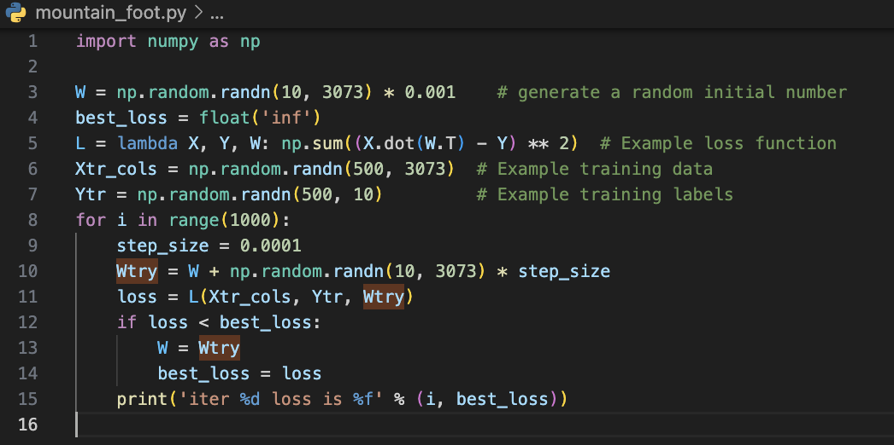
Neural Networks & Backpropagation
Pgm Realizing

Slide 51
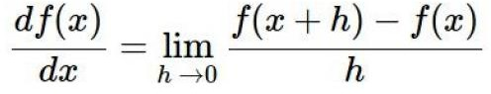
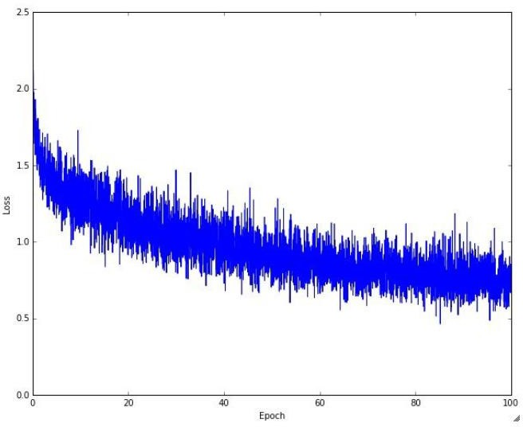
Neural Networks & Backpropagation
Visualized Loss trend
Gradient Alignment
Gradient Decent

Slide 52
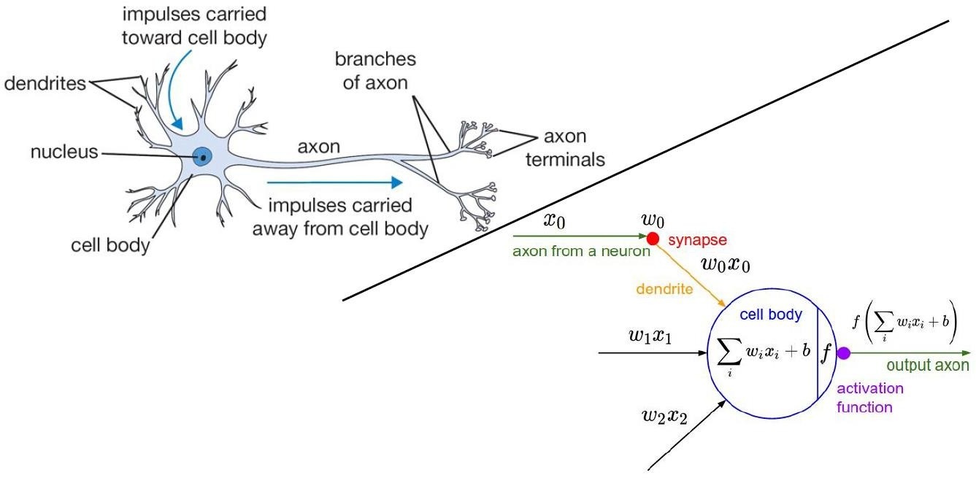
Neural Networks
http://cs.stanford.edu/people/karpathy/convnetjs/demo/classify2d.html

Slide 53
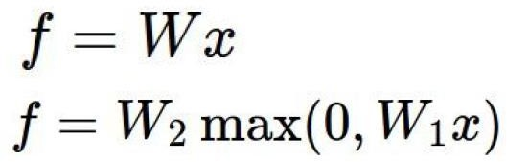
Neural Networks
Linear Equation
Nonlinear Equation

Slide 54
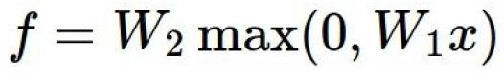
Neural Networks
Single Layer NN
Multi-layer NNs

Slide 55
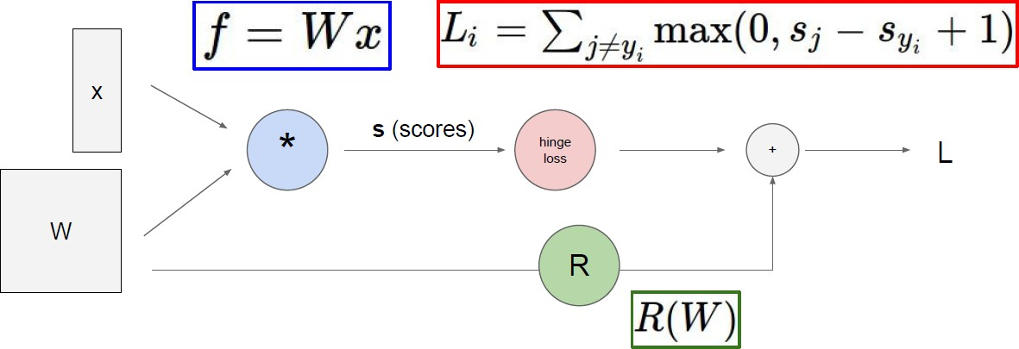
Backpropagation

Slide 56
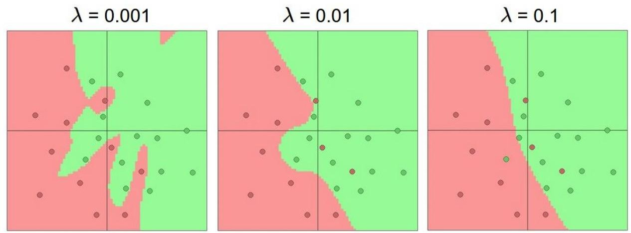
Neural Networks
Regularization in NNs

Slide 57
Neural Networks
The more neurons there are, the more complex models can be parse.

Slide 58
Neural Networks
Single Layer NN
Multi-layer NNs

Slide 59
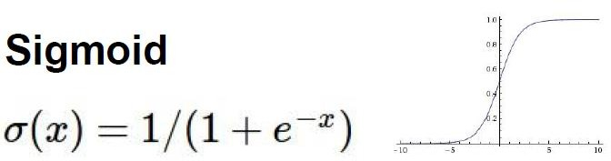
Neural Networks
Sigmoid : neuro triggering function

Slide 60
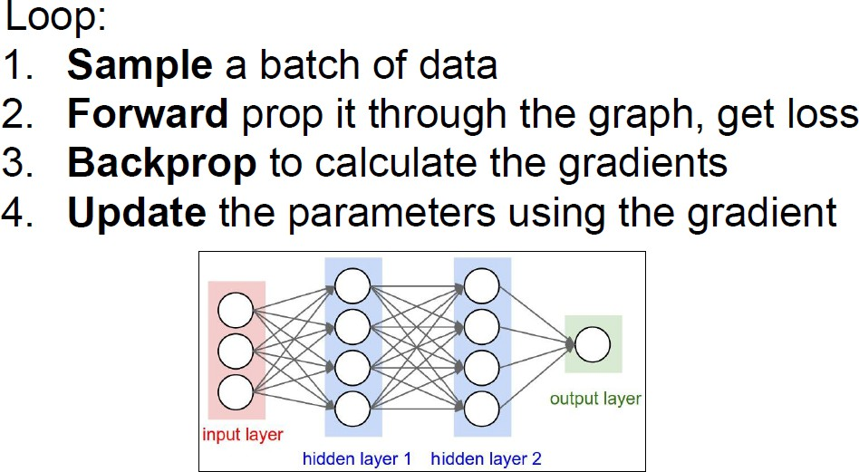
CNNs(Convolutional Neural Networks)

Slide 61
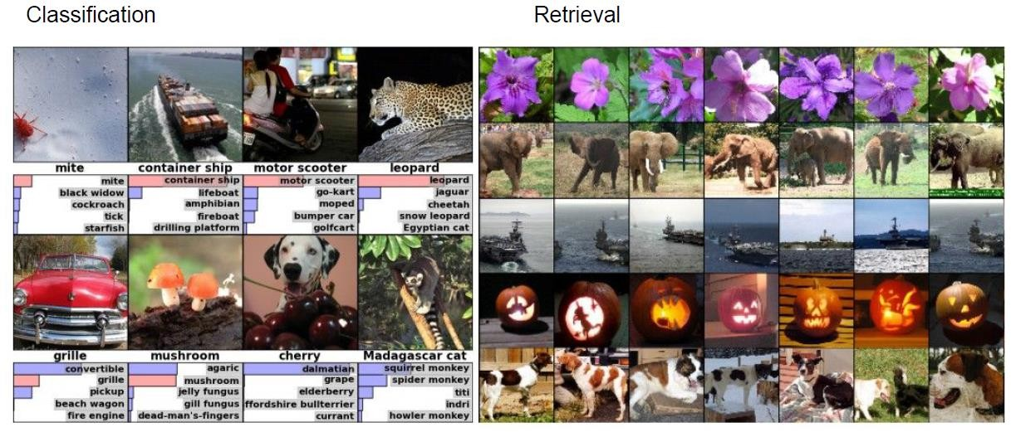
CNNs(Convolutional Neural Networks)

Slide 62
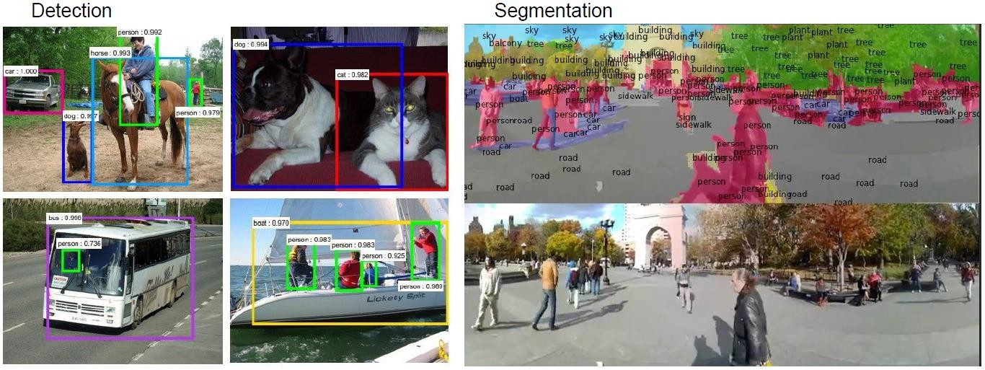
CNNs(Convolutional Neural Networks)

Slide 63
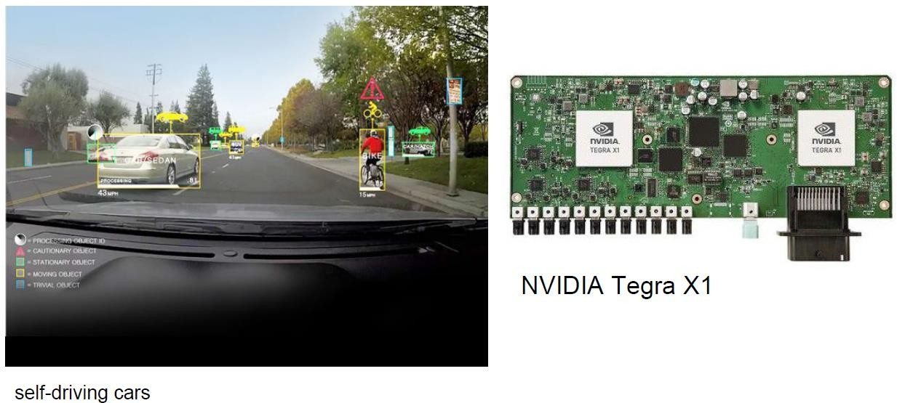
CNNs(Convolutional Neural Networks)

Slide 64
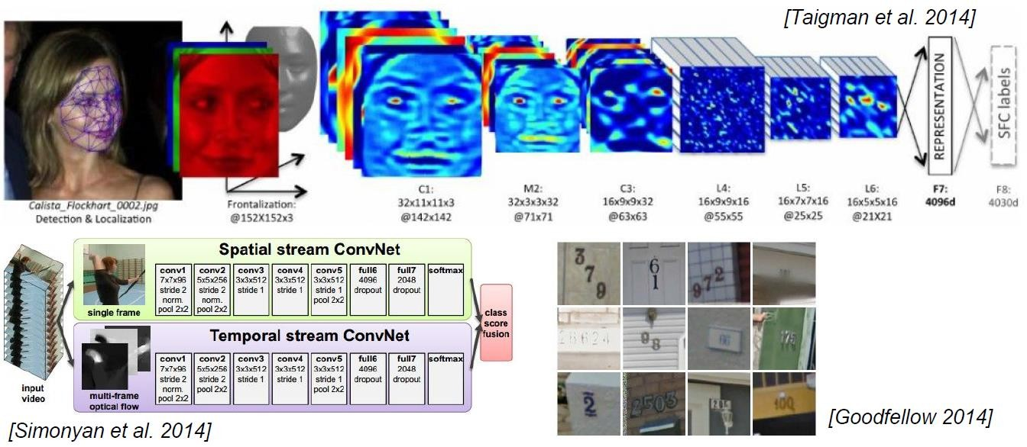
CNNs(Convolutional Neural Networks)

Slide 65
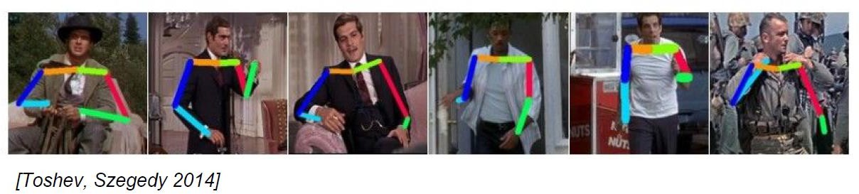
CNNs(Convolutional Neural Networks)

Slide 66
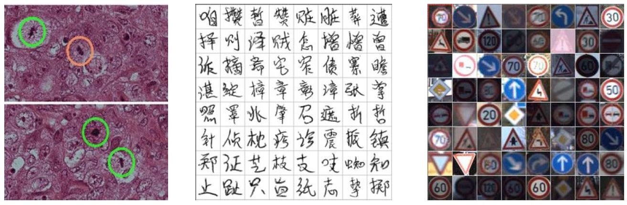
CNNs(Convolutional Neural Networks)

Slide 67
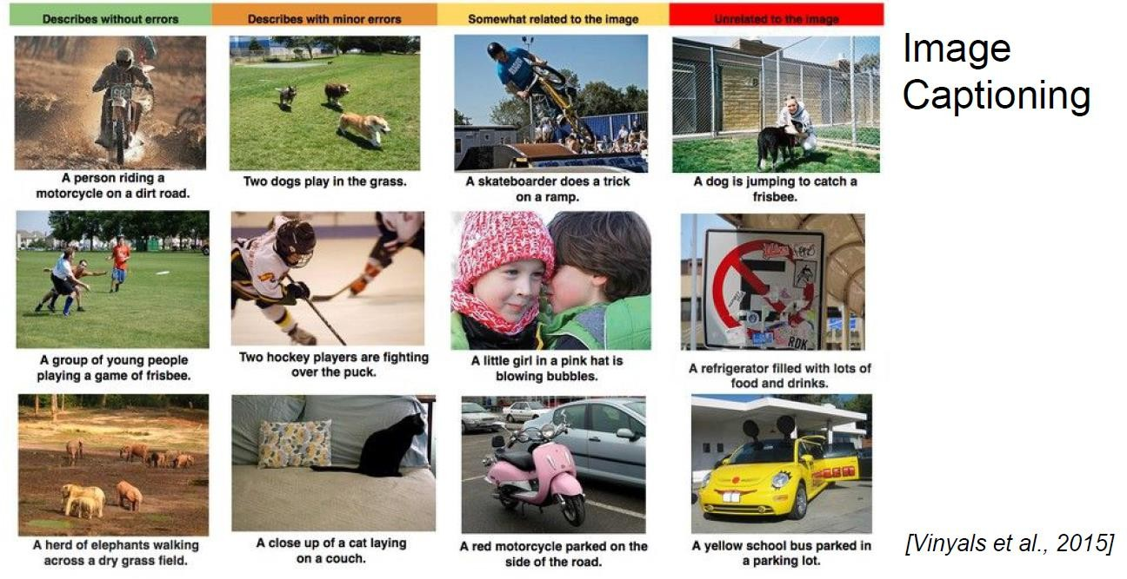
CNNs(Convolutional Neural Networks)

Slide 68
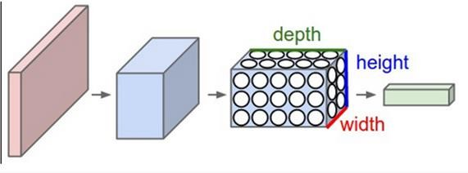
CNNs(Convolutional Neural Networks)
[INPUT - CONV - RELU - POOL - FC]
Input
Convolution
ReLU active function
Pooling
Full Connect

Slide 69
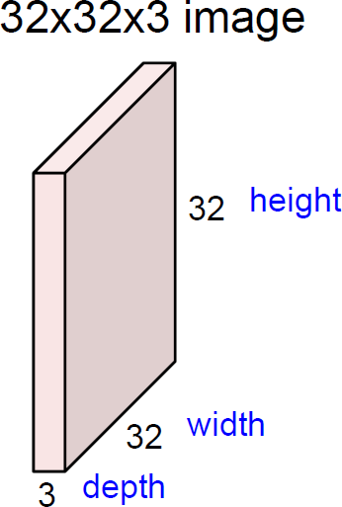
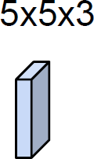
CNNs(Convolutional Neural Networks)

Slide 70
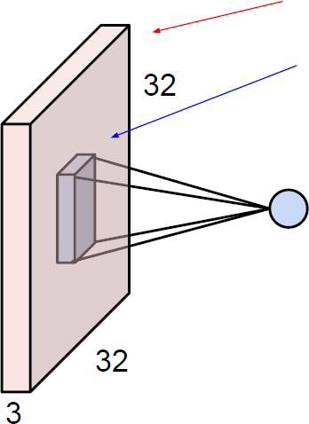
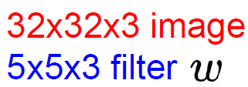
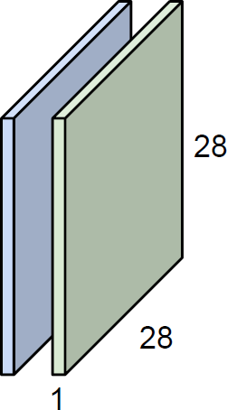
CNNs(Convolutional Neural Networks)

Slide 71
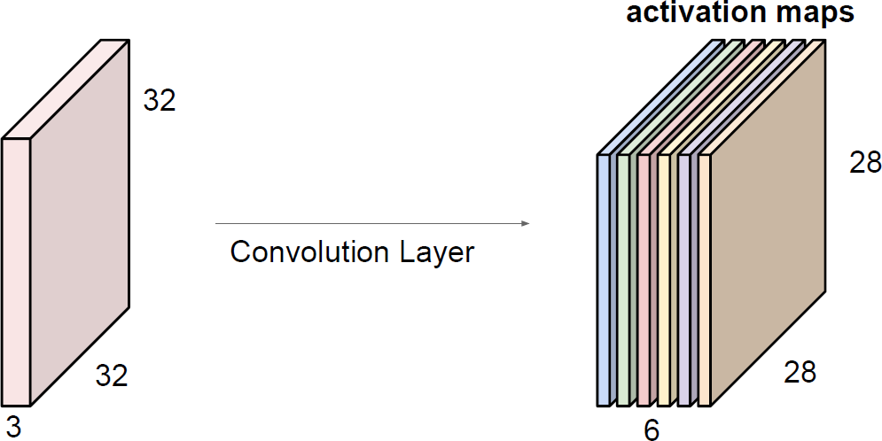
CNNs(Convolutional Neural Networks)

Slide 72
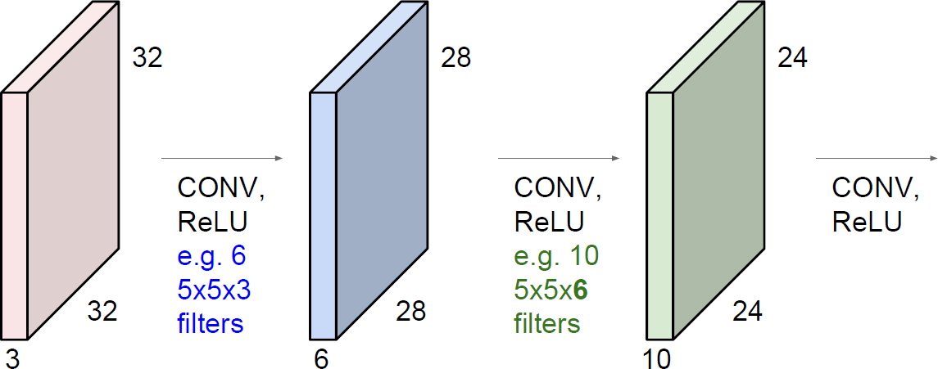
CNNs(Convolutional Neural Networks)

Slide 73
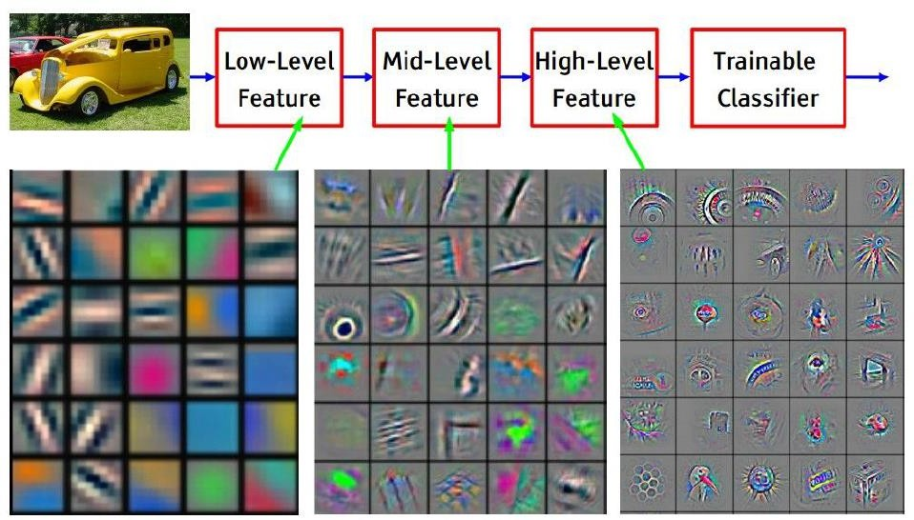
CNNs(Convolutional Neural Networks)

Slide 74
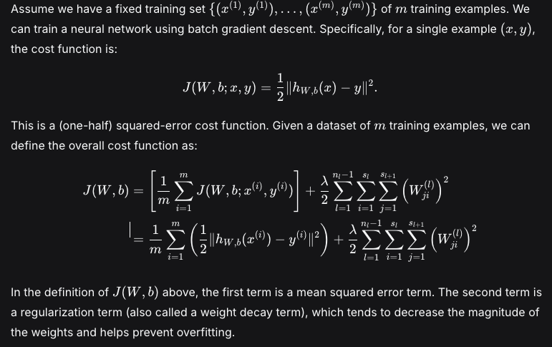
RNNs （Recurrent Neural Networks)

Slide 75
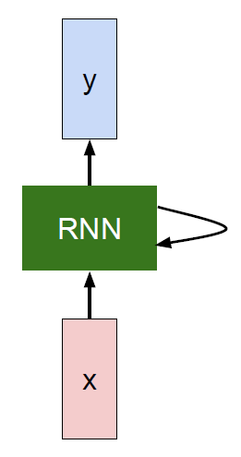
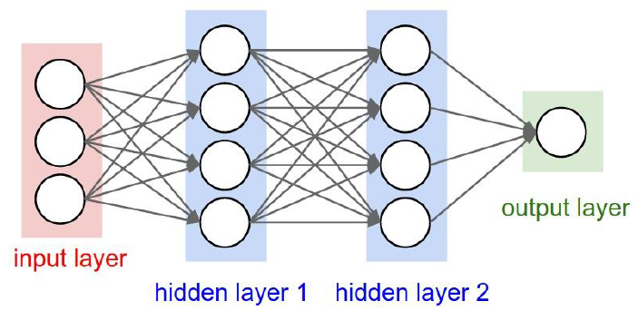
RNNs （Recurrent Neural Networks)

Slide 76
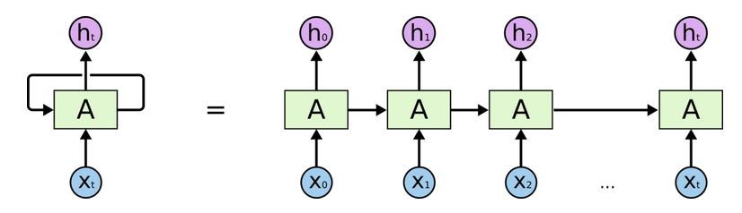
RNNs （Recurrent Neural Networks)

Slide 77
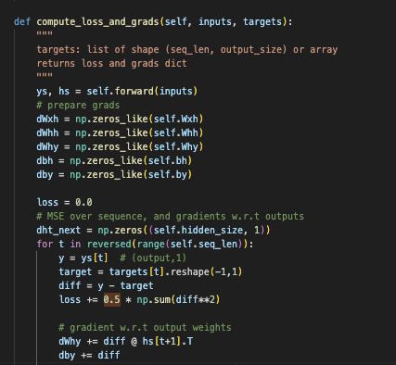
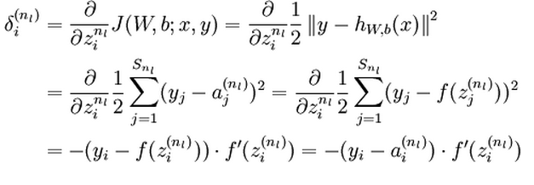
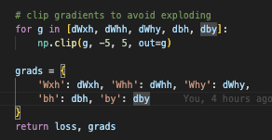
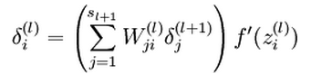
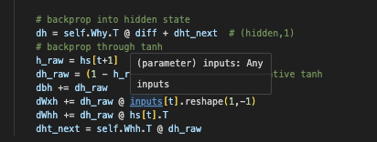
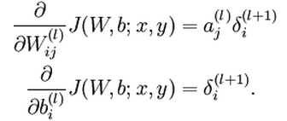
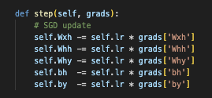
RNNs （Recurrent Neural Networks)
http://deeplearning.stanford.edu/wiki/index.php/UFLDL_Tutorial

Slide 78
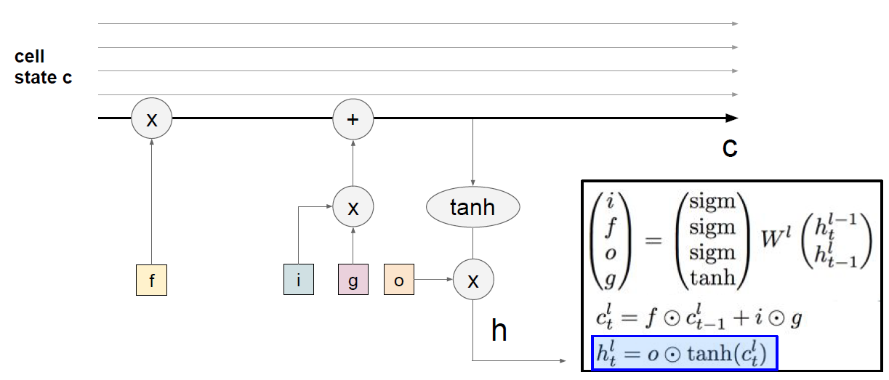
LSTM( Long short-term memory)

Slide 79
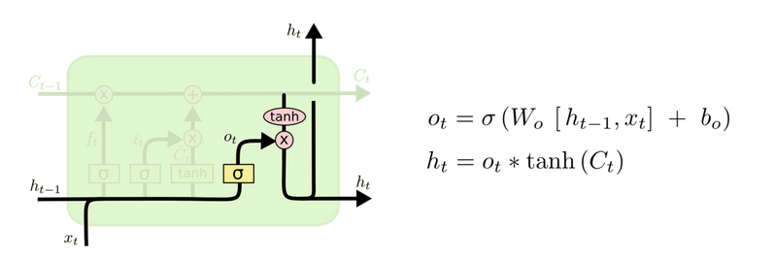

LSTM( Long short-term memory)
Sigmoid
The cell state undergoes tanh processing (yielding a value between tanh : -1 and 1) and is multiplied by the output of the sigmoid gate. Ultimately, we only output the portion we have determined to be the final output.

Slide 80
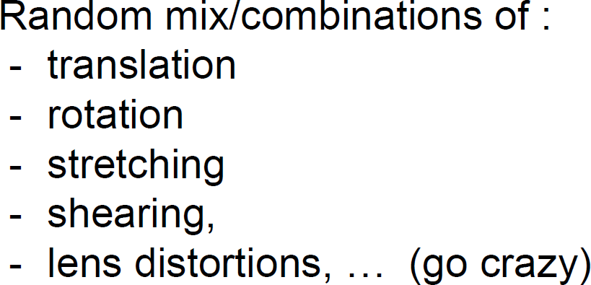
Transfer Learning & Data Augmentation

Slide 81
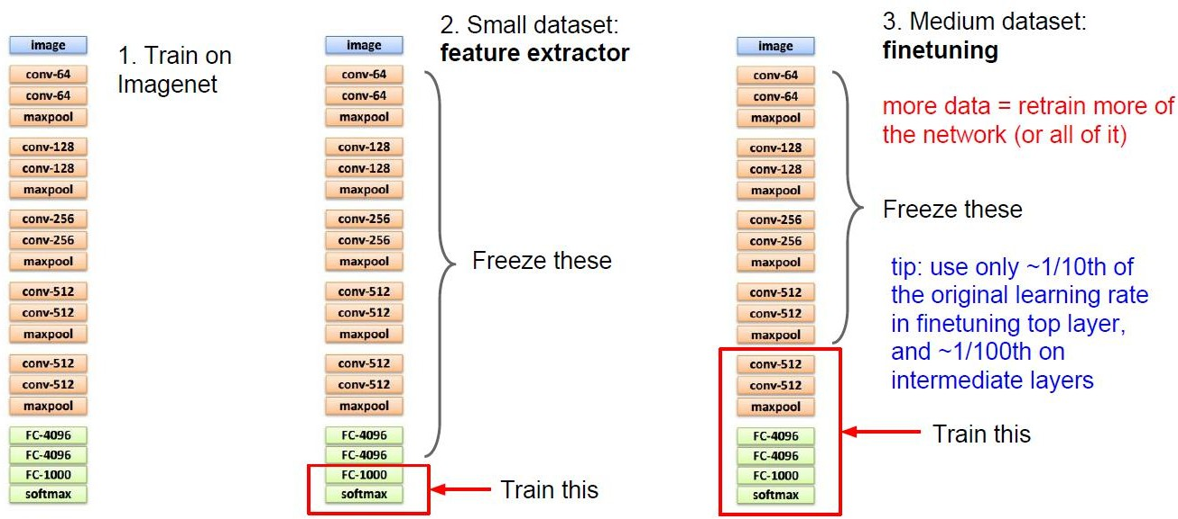
Transfer Learning & Data Augmentation

Slide 82
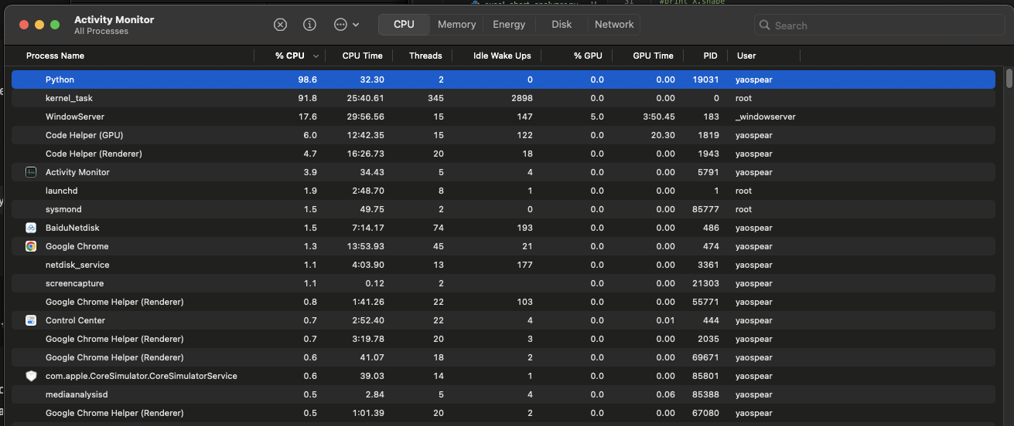
Hardware: GPUs & TPUs

Slide 83
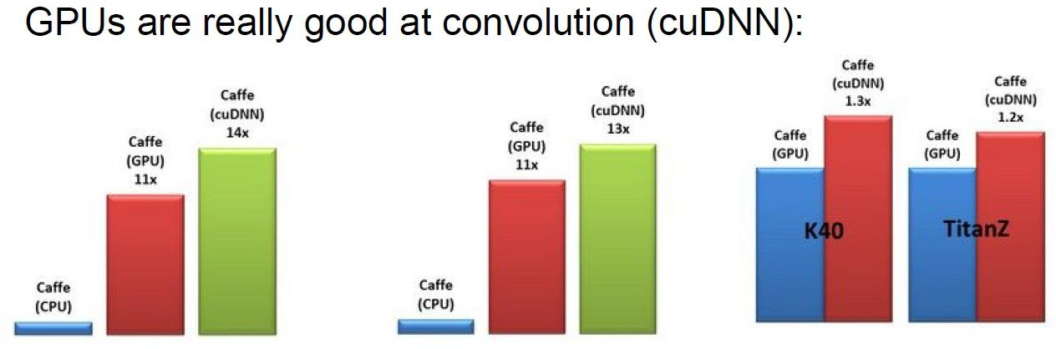
Hardware: GPUs & TPUs

Slide 84
Practical Demo: OCR, Prediction
Optical Character Recognition – Chinese ID Information Recognition (for educational purposes).
Example1:Exercies1: Shanghai Real Estate Price Prediction
Example2: Exercies2: Lottery result prediction

Slide 85
Day3

Slide 86
Large Language Models (LLMs)
LLaMA, GPT, DeepSeek, BLOOM, Transformers
Tokenization, Embeddings, Fine-tuning with Hugging Face
Applications: Chatbots, Summarization, Q&A

Slide 87
Large Language Models (LLMs)
The Transformer architecture was introduced in the 2017 paper titled "Attention Is All You Need." which is the foundation theory of NLP(Natural Language Processing).The paper was authored by eight Google researchers:
Ashish Vaswani
Noam Shazeer
Niki Parmar
Jakob Uszkoreit
Llion Jones
Aidan N. Gomez
Łukasz Kaiser
Illia Polosukhin

Slide 88
LLaMA, GPT, DeepSeek, BLOOM, Transformers
A Transformer model is the foundational architecture behind modern Large Language Models (LLMs) like GPT, BERT, and Claude. It was introduced by Google in the 2017 paper “Attention Is All You Need.”
The Transformer replaces older sequential models (like RNNs or LSTMs) with a parallelizable attention mechanism — allowing the model to focus on the most relevant parts of an input sequence.
⚙️ Key Components
1. Encoder–Decoder Structure
Encoder: Reads and represents the input text (e.g., a sentence).
Decoder: Generates the output (e.g., translated text, response, or prediction). 2. Attention Mechanism
The heart of the Transformer is self-attention, which computes how much each word should attend to others in a sentence.
3. Positional Encoding
Because Transformers process sequences in parallel (not step-by-step), positional encodings are added to give the model information about the order of words.
4. Feedforward Layers
After attention, each token representation passes through a small neural network that refines its meaning.

Slide 89
LLaMA, GPT, DeepSeek, BLOOM, Transformers
🧩 Simplified Architecture Flow
Input text → Embedding → Self-Attention → Feedforward → Output (contextual meaning)
⚡ Advantages
Highly parallelizable (fast training)
Handles long-range dependencies well
Scales effectively to billions of parameters
Model | Type | Description
BERT | Encoder-only | Great for understanding & classification
GPT | Decoder-only | Great for text generation
T5 / FLAN-T5 | Encoder–Decoder | Great for translation, summarization
PaLM / LLaMA / Claude / Gemini | Decoder-based LLMs | Advanced text reasoning & generation

Slide 90
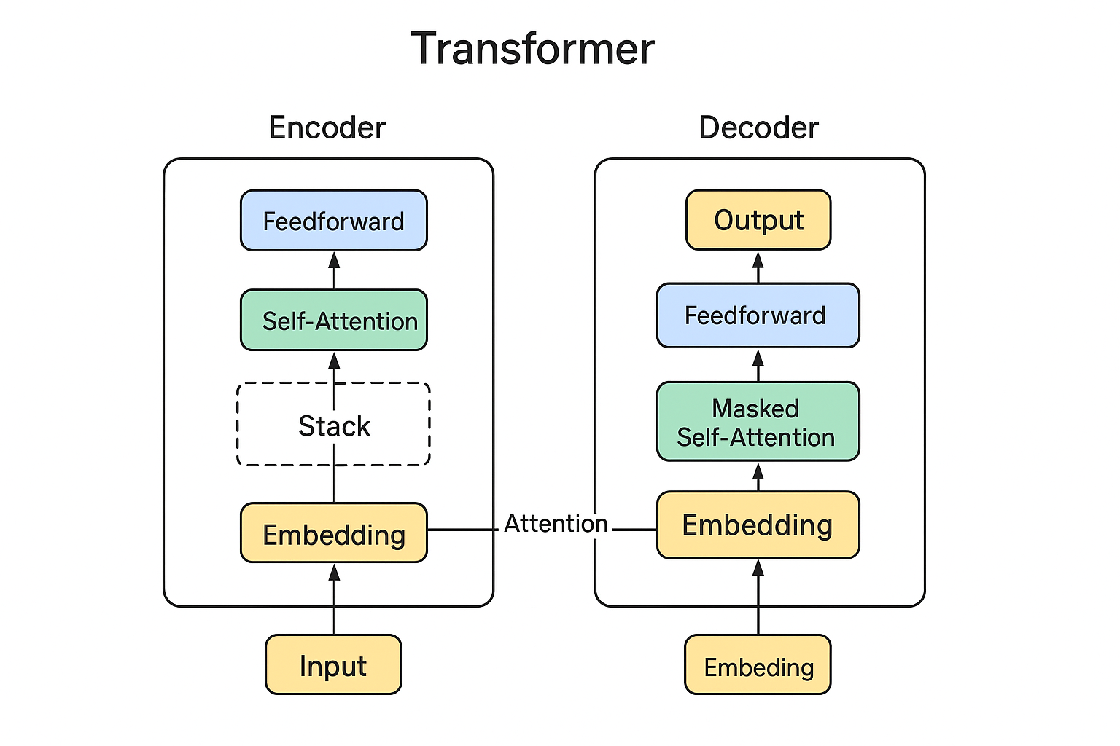
LLaMA, GPT, DeepSeek, BLOOM, Transformers

Slide 91
LLaMA, GPT, DeepSeek, BLOOM, Transformers
1. GPT (Generative Pre-trained Transformer)
Developer: OpenAI.
Significance: GPT models (GPT-3, GPT-4, etc.) are the pioneers of the modern LLM era. They popularized the Generative and Pre-trained approach, showcasing unprecedented capabilities in conversation, coding, and general knowledge. GPT is known for being closed-source (proprietary), with access primarily through an API.
2. LLaMA (Large Language Model Meta AI)
Developer: Meta AI (Facebook).
Significance: LLaMA (and its successor, Llama 2) introduced high-performance models that were initially openly released (though with some licensing restrictions), dramatically boosting the open-source AI community. Its high quality and efficient architecture made it the primary choice for researchers and companies building their own custom models.

Slide 92
LLaMA, GPT, DeepSeek, BLOOM, Transformers
3. BLOOM (BigScience Large Open-science Open-access Multilingual)
Developer: BigScience (a collaboration of over a thousand researchers).
Significance: BLOOM is notable for being a truly open-science, multilingual LLM. It was trained on a massive, diverse dataset to be highly proficient across 46 natural languages and 13 programming languages. Its purpose was to democratize access to powerful AI models for the global research community.
4. DeepSeek
Developer: DeepSeek AI (a Chinese-based company).
Significance: DeepSeek models are known for their competitive performance, often matching or exceeding their contemporaries, particularly in coding and Chinese language tasks. They represent the growing global diversity in high-performance LLM development, with a focus on both general language and specialized domains.

Slide 93
LLaMA, GPT, DeepSeek, BLOOM, Transformers
Transformers: The Foundation 🧱
The Transformer is the revolutionary deep learning architecture that makes LLaMA, GPT, DeepSeek, and BLOOM possible. It was introduced by Google in 2017 in the paper "Attention Is All You Need.”
Transformer Components
The architecture consists of two main parts:
Encoder: Processes the input sequence and generates an understanding (often used for tasks like translation).
Decoder: Uses the understanding from the Encoder (and its own internal state) to generate the output sequence (often used for generation).

Slide 94
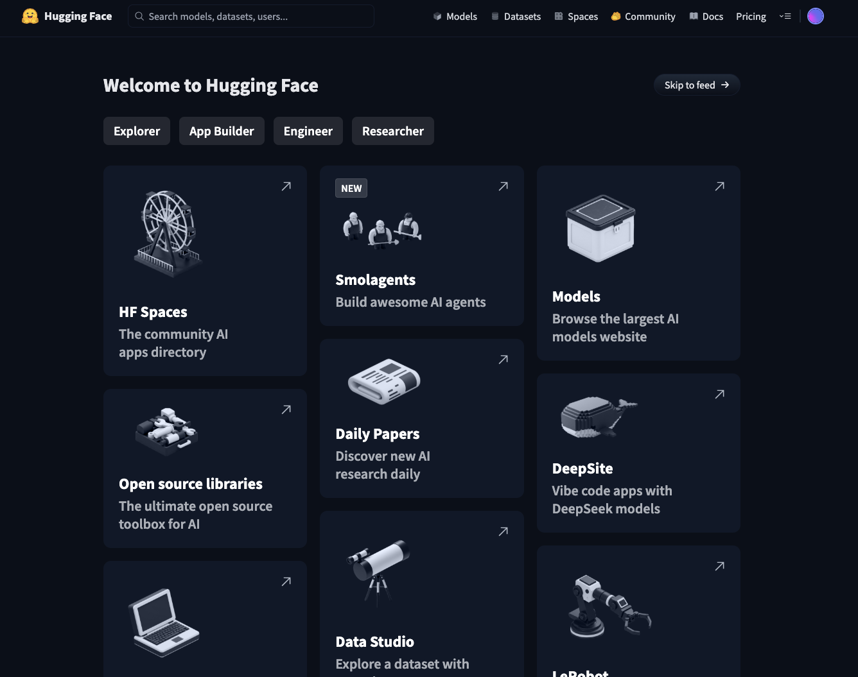
Tokenization, Embeddings, Fine-tuning with Hugging Face

Slide 95
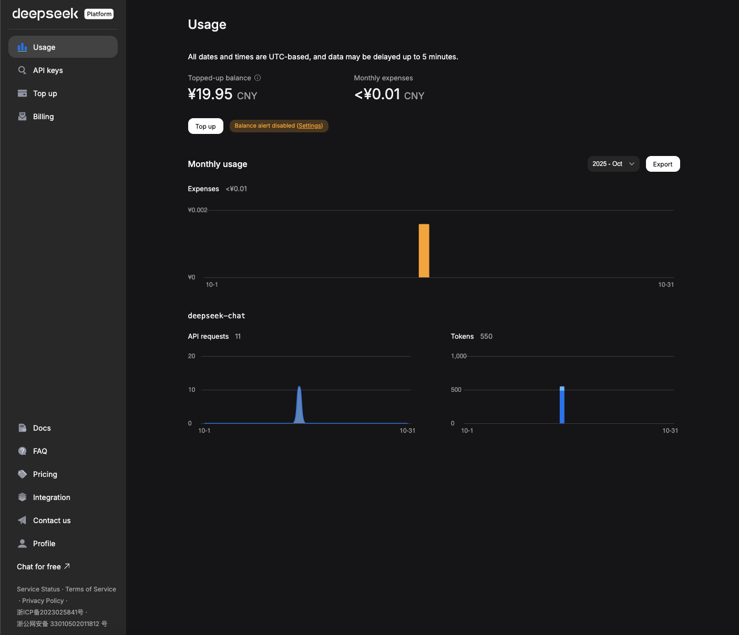
Tokenization, Embeddings, Fine-tuning with Hugging Face

Slide 96
How LLaMA, BLOOM, and GPT handle large-scale natural language tasks
All three handle large-scale tasks through:
Pre-training on massive datasets (hundreds of billions of tokens)
Transfer learning - general knowledge applied to specific tasks
Fine-tuning for domain-specific applications
Prompt engineering for zero-shot and few-shot learning
Distributed training across multiple GPUs/TPUs
Gradient checkpointing to manage memory during training

Slide 97
AI and text generation: Chatbots, summarization, Q&A, and sentiment analysis
All-in-One Platforms
For Multiple Applications:
OpenAI API (GPT-4) - All text generation tasks
Claude API (Anthropic) - Comprehensive text AI
Google Cloud AI Platform - Full suite of NLP tools
AWS AI Services - Complete ML/AI ecosystem
Azure Cognitive Services - Microsoft's AI toolkit
Hugging Face - Open-source models for everything
Best Practices for Tool Selection:
Consider scale: Cloud APIs for small projects, custom models for large-scale
Data privacy: On-premise solutions (Rasa) vs. cloud services
Customization needs: Open-source (Hugging Face) vs. managed services
Budget: Free tiers, pay-as-you-go, or enterprise licensing
Integration: Choose tools that work with your existing tech stack
Language support: Ensure tools support your target languages
Accuracy requirements: Test multiple tools before committing

Slide 98
Practical Demo: Hugging Face/DeepSeek API(60mins)
Text generation with LLaMA or DistilBERT
Private MCP setup & fine-tuning.
AI-powered Chatbot using DeepSeek + Flutter.
const String deepseekApiKey = "sk-9362d28569be445f9a9cb77056d28795";
const String deepseekApiUrl = "https://api.deepseek.com/v1/chat/completions";

Slide 99
Capstone Project
Build an AI Assistant using LLaMA / DeepSeek(summarization) & TensorFlow (classification)

Slide 100
Wrap-Up & Future of AI
AI history from Turing Test to modern deep learning Government applications: chatbots, smart cities, security, healthcare, fraud detection AI infrastructure: cloud vs on-premise, TensorFlow, PyTorch, Hugging Face Demo: DeepSeek API in office software
ML pipeline: data prep, training, testing, evaluation Models: classification, regression, clustering Neural networks, CNNs, RNNs Demos: Lottery prediction, real estate pricing, Chinese ID OCR Large language models: LLaMA, GPT, DeepSeek, BLOOM Transformers, tokenization, fine-tuning Text generation: chatbots, summarization, Q&A, sentiment analysis Capstone: Build AI assistant with LangChain and FastAPI Demo: DeepSeek chatbot on Flutter mobile app
Edge AI — running large models locally (on phones, cars, IoT) for privacy and speed.
Quantum AI — quantum computing accelerating complex model training and reasoning.
Agentic AI ecosystems — autonomous agents that cooperate, negotiate, and transact economically (e.g., AI businesses or “autonomous corporations”).

Slide 101
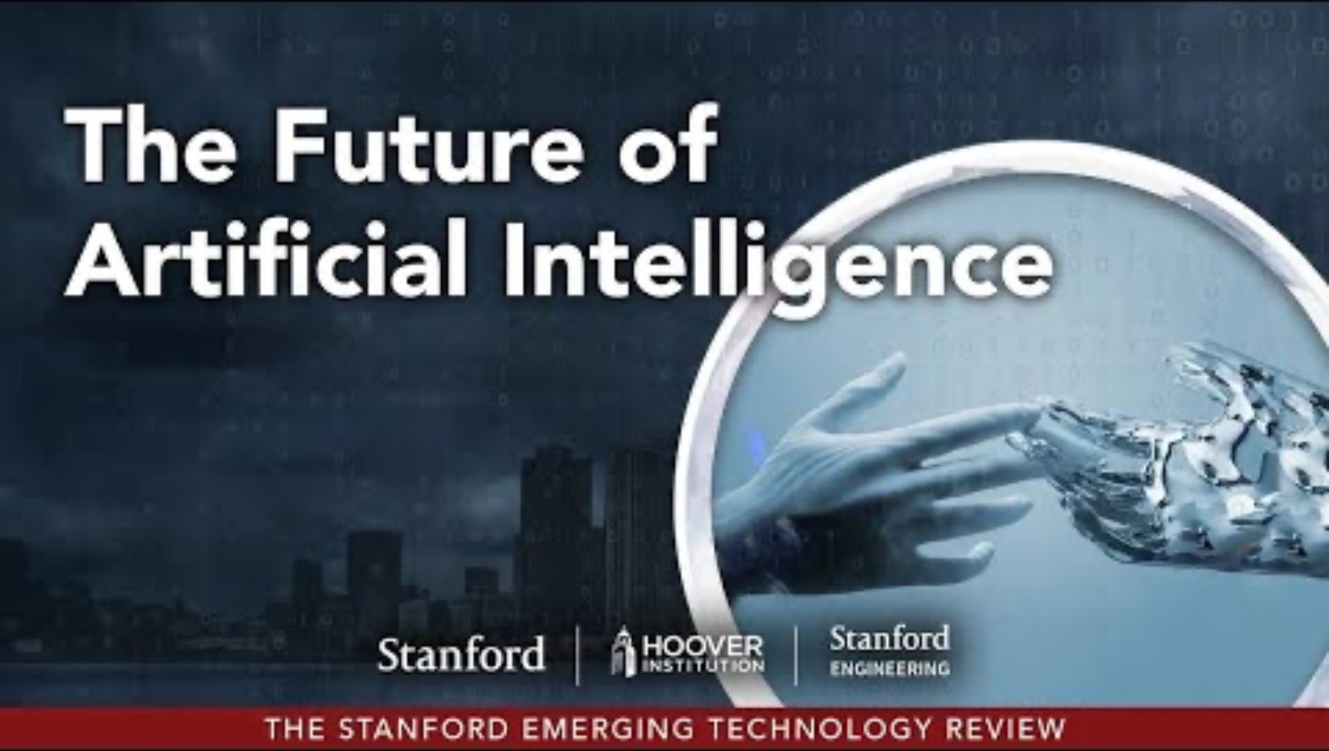
Future of AI

Slide 102
Key Tools & Frameworks
Languages: Python, C++,Javascript Dart
Libraries: TensorFlow, PyTorch, Hugging Face, LangChain
Platforms: DeepSeek Dev Plastform,Hugging Face Hub, TensorFlow Hub
Models:DeepSeek,GPT2, LLaMA 2, BLOOM, BERT, Whisper

Slide 103
Thank You!

